Slide 1

Let’s start with the A B C++
What is C++ ?
C++ is an object-oriented programming language which allows code to be reused, lowering development cost.
C++ gives programmers a high level of control over system resources and memory.
C++ is a powerful, high-performance language used in a wide range of domains. For example - Operating system development, Game development, Scientific computing and simulations, Machine Learning (Back-end libraries), compilers and interpreters.

Slide 2
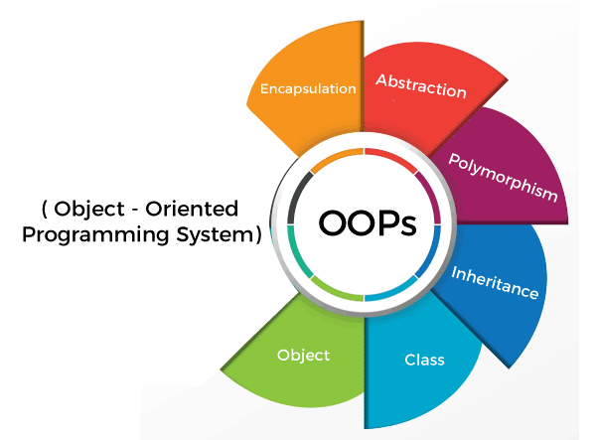
OOPS!! – Object Oriented Programming System.

Slide 3
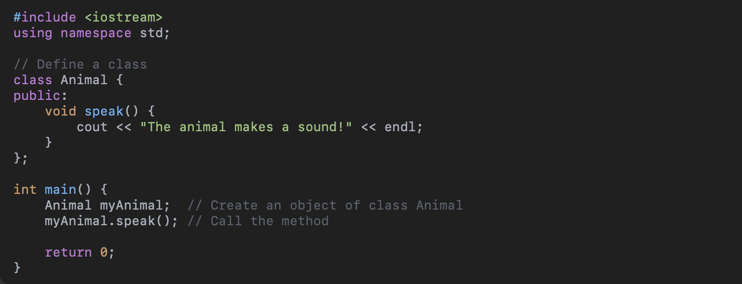
Object-Oriented Programming (OOP) is a programming paradigm that organizes code around objects rather than actions or logic.
An object is a structure that contains both:
Data (called attributes or properties)
Behavior (called methods or functions)
Why Use OOP?
Makes code more organized, reusable, and easier to maintain.
Helps in modeling real-world systems more intuitively.

Slide 4
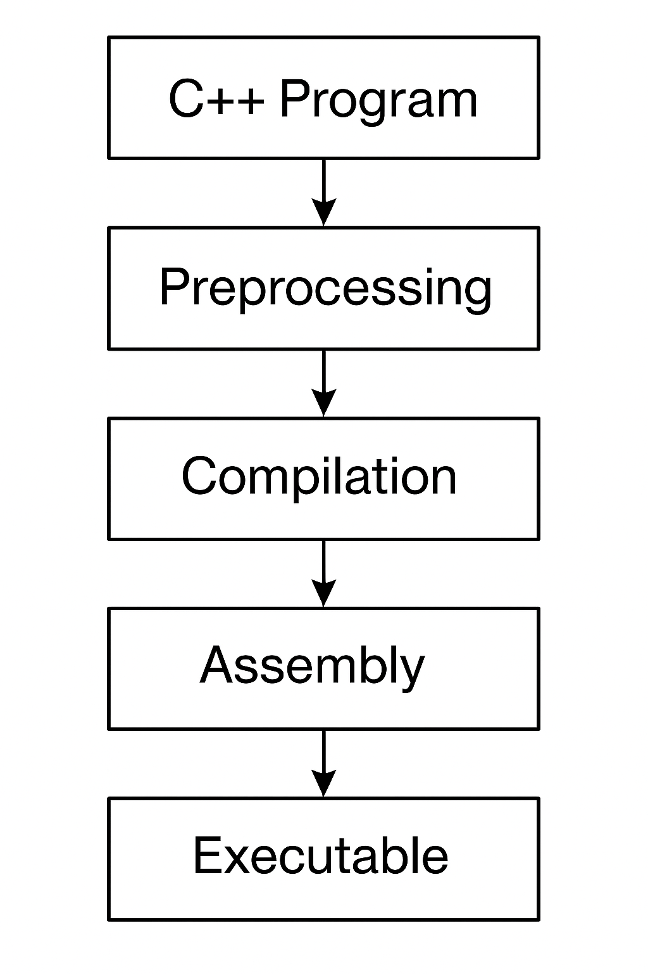
What is a Compiler?
A compiler is a program that translates code written in a high-level language (like C++) into machine code (binary) that the computer can execute.
It checks for syntax errors and ensures the code follows language rules.
If successful, it generates an executable file (like .exe on Windows).

Slide 5
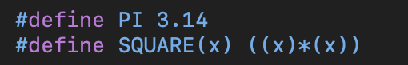

Preprocessing statements
#include – Header Files
#define – defines macros (constant or simple functions)
#undef – undefines macros
#pragma – Compiler specific instructions.

Slide 6
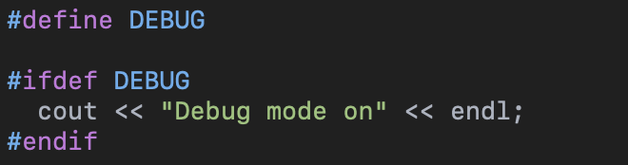
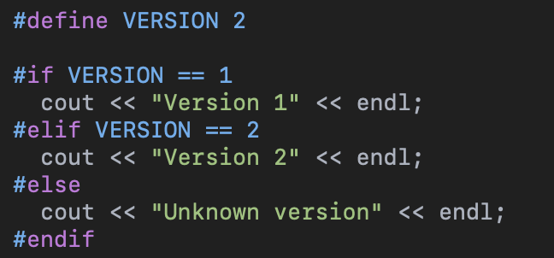
Conditional Compilation
#ifdef and #ifndef
#if, #elif, #else, #endif

Slide 7
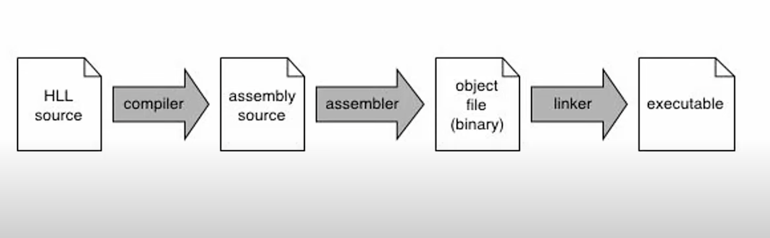
Linkers
What is a Linker in C++?
A linker combines multiple object files (.o or .obj) into a single executable.
It runs after compilation.
Resolves references between functions, variables, and libraries.
How the Linker Works
Takes object files generated by the compiler.
Resolves symbols:
Finds definitions for all functions and variables used across files.
Combines code into a single executable or library.
Handles external libraries (like iostream, math, etc.).
Can also perform optimizations (e.g. remove unused code).

Slide 8
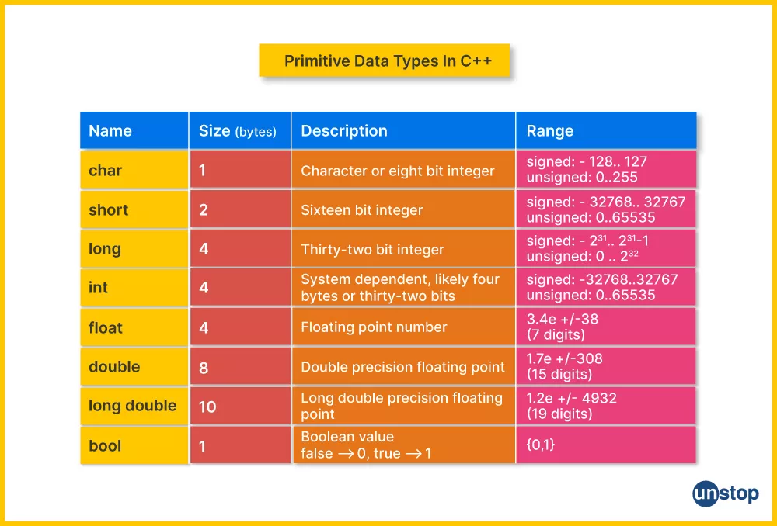
Variables in C++
Basic Data Types in C++
int – Integer values (e.g., 5, -42) [4 bytes]
float – Decimal numbers with single precision (e.g., 3.14) [4 bytes]
double – Decimal numbers with double precision [8 bytes]
char – Single characters (e.g., 'A’) [1 byte]
bool – Boolean values (true or false) [1 byte]
void – Used for functions that return no value [0 byte]
Modifiers for Data Types
short, long, signed, unsigned
Used to change size or sign of integers
Example: unsigned int, long long int

Slide 9
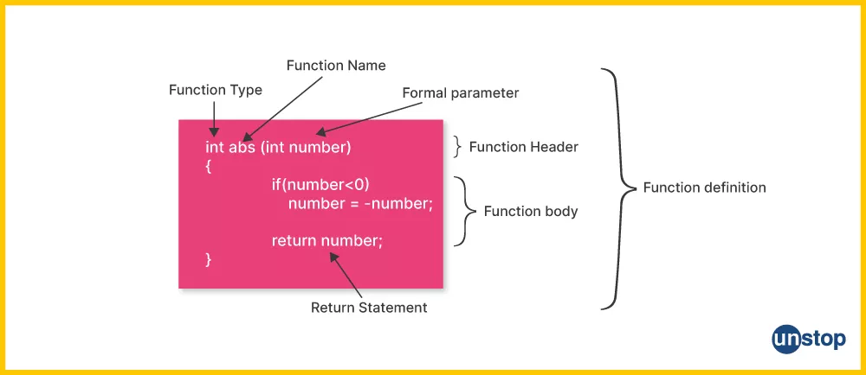
Functions in C++
What Are Functions in C++?
A function is a block of code that performs a specific task.
Helps in code reuse, organization, and modularity.
Can be called multiple times from different parts of the program.
Structure of a Function
A function typically includes:
Return type (e.g., int, void)
Function name
Parameters (optional)
Function body (code block)
Types of Functions
User-defined functions – Created by the programmer.
Predefined functions – Already available in C++ libraries (e.g., sqrt(), cout).

Slide 10
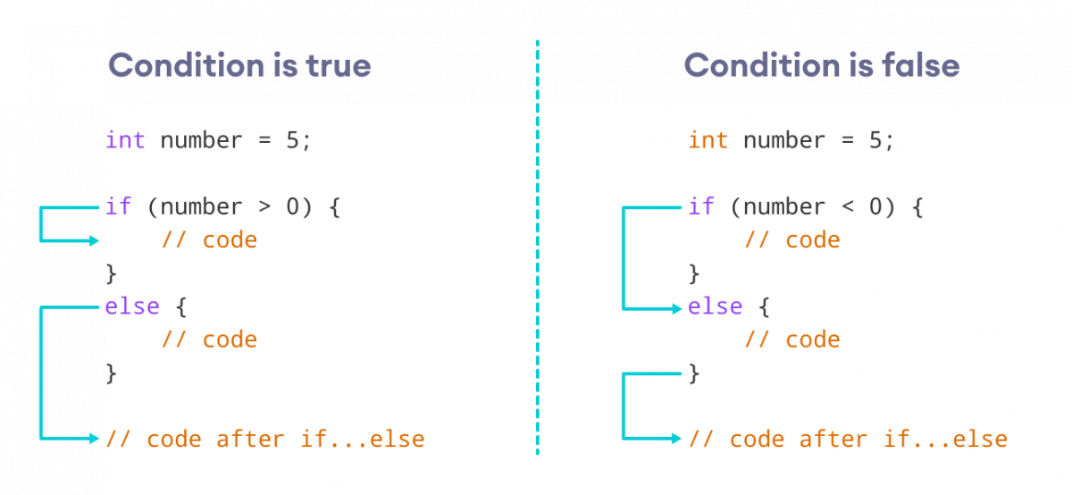
Conditions and Branches in C++
Control the flow of a program based on conditions.
Allow programs to make decisions.
Use if, else if, else, and switch statements.

Slide 11
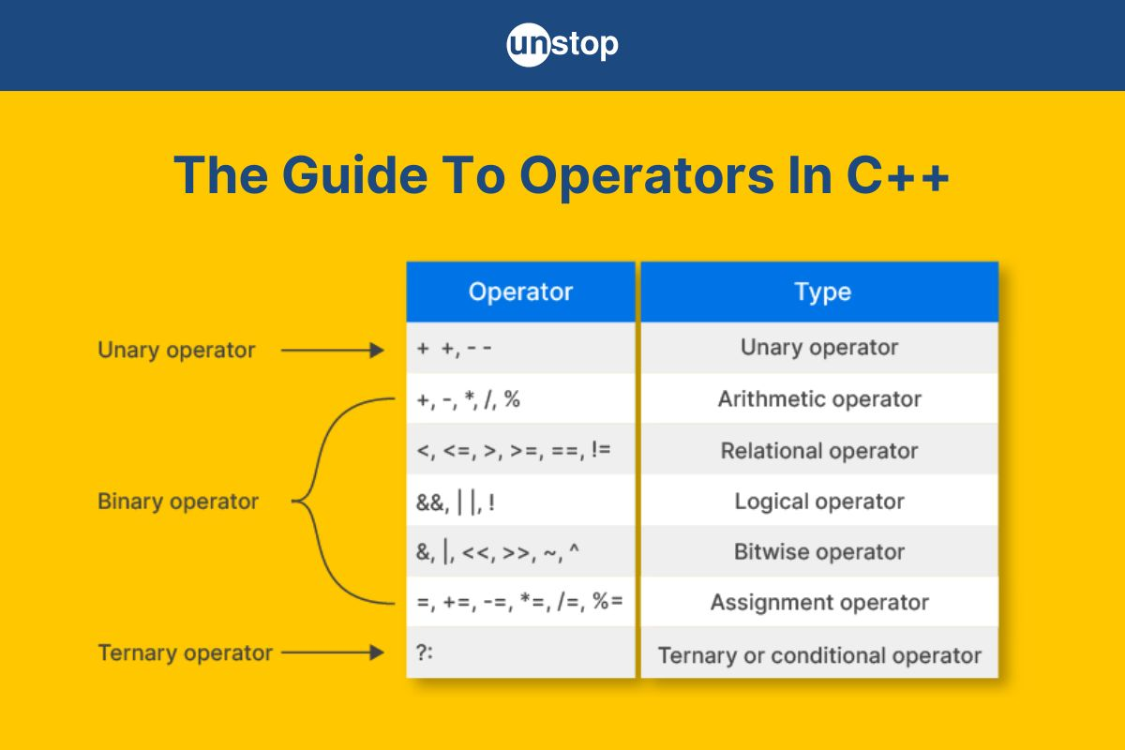
Operators
Logical Operators
Combine or invert conditions.
&& (Logical AND) – true if both conditions are true.
|| (Logical OR) – true if at least one condition is true.
! (Logical NOT) – inverts the condition.
Relational Operators
Compare values:
== (equal to)
!= (not equal to)
<, >, <=, >=
Used inside conditions.

Slide 12
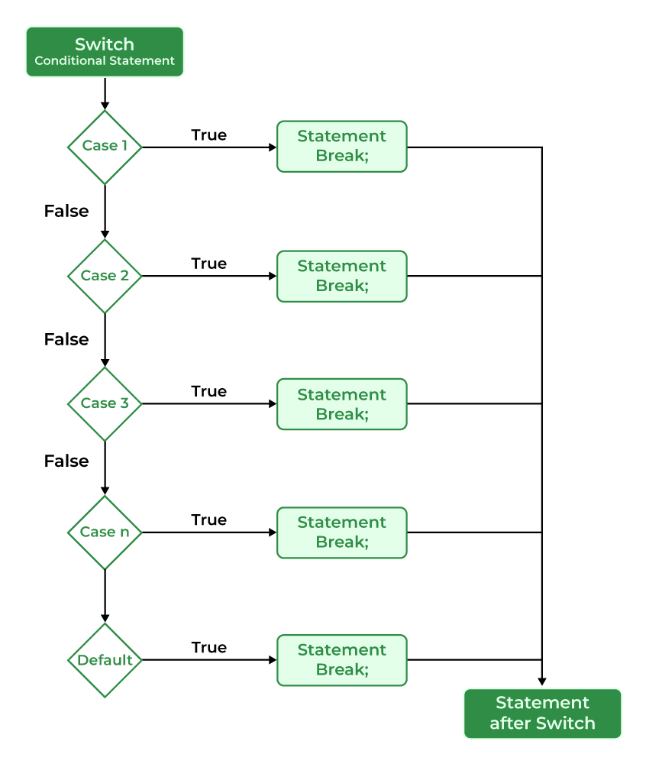
Switch statements
What is a switch Statement?
A control statement that tests a variable against multiple constant values.
Often used as a cleaner alternative to multiple if-else statements.
Common Use Cases
Menus and options selection
Command handling
State machines
Best Practices
Always include break unless intentional fall-through is needed.
Include a default to handle unexpected values.
Avoid complex logic inside switch for readability.

Slide 13
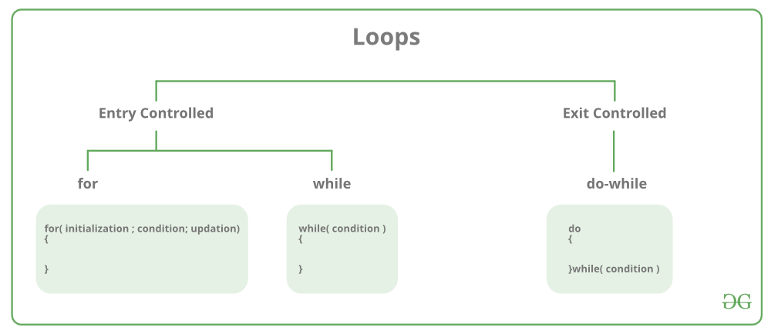
Loops in C++
Introduction to Loops in C++
Loops are used to execute a block of code repeatedly.
Reduce code repetition and improve readability.
Types of Loops in C++
for loop – Best for known number of iterations.
while loop – Best for unknown number of iterations (pre-condition loop).
do-while loop – Like while, but guarantees the body runs at least once (post-condition loop).

Slide 14
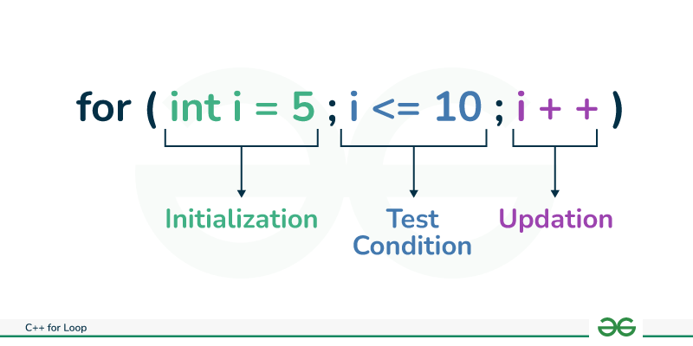
for loops
A for loop is used when the number of iterations is known or predetermined.
Syntax structure allows initialization, condition, and increment/decrement to be declared in one line.
Key Components
Initialization: Runs only once at the start. Typically used to declare and initialize the loop counter.
Example: int i = 0;
Condition: Evaluated before each iteration. If true, the loop executes; if false, the loop exits.
Example: i < 10
Increment/Decrement: Updates the loop variable after every iteration.
Example: ++i or i += 2

Slide 15
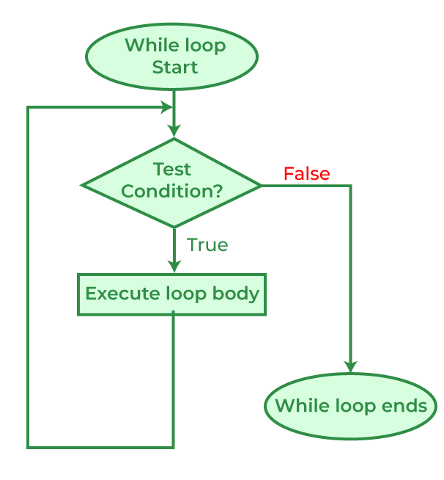
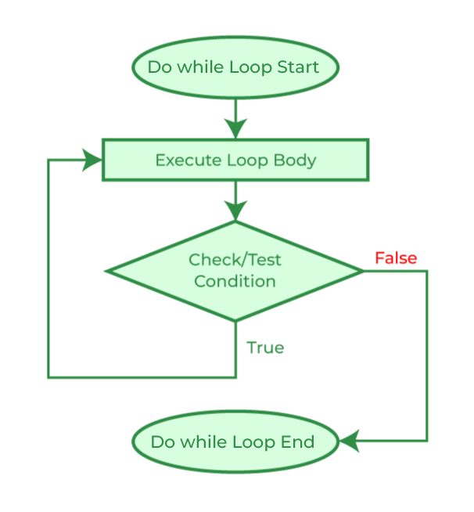
while and do while loops
while loop
Key Concepts
Repeats the loop as long as the condition is true.
The condition is checked before each iteration.
If the condition is false at the beginning, the loop body may not execute even once.
Common Pitfalls
Forgetting to update the loop control variable → infinite loop.
Accidentally creating unreachable code if the condition is initially false.
Use Cases
When the number of iterations is unknown or depends on user input or external state.
Useful in reading input until EOF, waiting for a signal, etc.
do while loop
Key Concepts
The loop body executes at least once, even if the condition is false initially.
The condition is evaluated after the loop body.
Use Cases
Menu systems that display at least once.
Input validation (prompt until valid input).
Situations where the action must occur before checking the condition.
Common Pitfalls
Misplacing the semicolon.

Slide 16
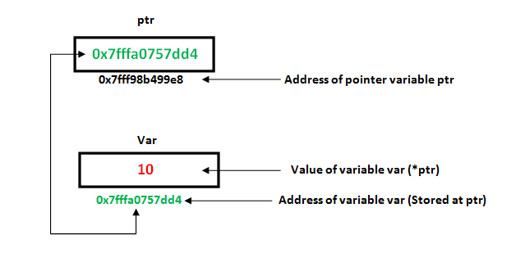
Pointers in C++
Pointer basics: A pointer is just an integer under the hood—specifically, it holds a memory address.
Declaration & initialization: Example syntax: int* ptr = &x; — ptr now stores the address of variable x.
Dereferencing: Using *ptr lets you access or modify the value stored at that address.
Pointer arithmetic: You can add/subtract integers to move the pointer across memory (e.g. via arrays).
Type matters: Pointers are typed (int*, char*, etc.), which tells the compiler how much memory to access.

Slide 17
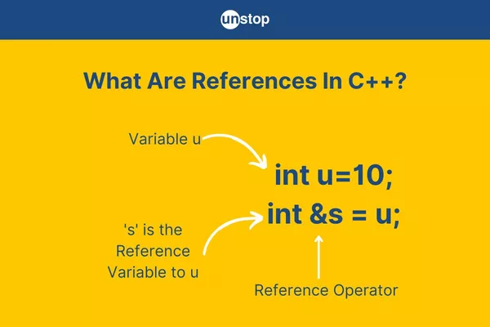
References in C++
A reference is an alias for another variable — it must refer to an existing variable.
Example: int a = 5; int& ref = a;
Unlike pointers, references cannot be null and must be initialized at declaration.
Syntax uses & in the declaration:
int& ref = x; ➝ ref is another name for x.
Changes via the reference affect the original variable:
ref = 10; changes x if ref refers to x.
Commonly used for:
Function parameters to avoid copying large objects (void foo(const MyClass& obj))
Return values when you want to return a variable by reference
No reassignment: Once a reference is bound to a variable, it cannot refer to another.
Reference vs Pointer:
Reference is automatically dereferenced.
Reference is safer and cleaner, but less flexible than a pointer.

Slide 18
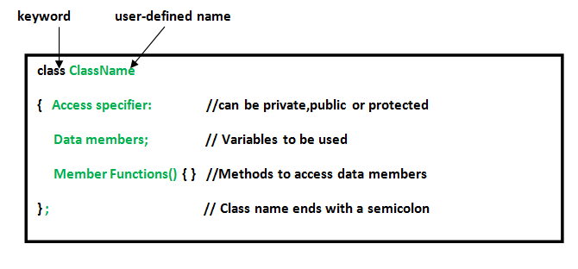
Classes and objects in C++
Classes
Blueprint for creating objects.
Can have variables (data members) and functions (methods).
Objects
Instance of a class.
Created like: MyClass obj;
Access members with obj.x or obj.print();
Access specifiers define visibility:
public: accessible from outside the class
private (default): accessible only within the class
protected: accessible in derived classes (used in inheritance)

Slide 19
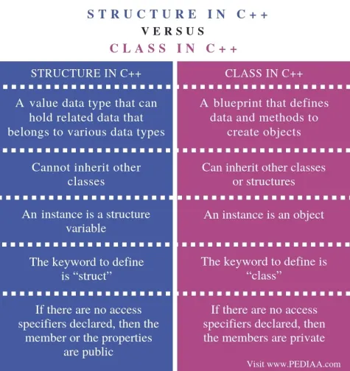
Class vs structs in C++
Both can have:
Member variables and functions
Constructors and destructors
Inheritance and access specifiers
Key Differences
class members are private by default
struct members are public by default
class is generally used for object-oriented design
struct is often used for plain data structures (like in C)
Semantically, there’s no functional difference beyond default access levels

Slide 20
Constructors and destructor in a class.
Constructors
Special function called automatically when an object is created.
Same name as the class, no return type.
Can be overloaded (multiple constructors with different parameters).
Used to initialize data members.
Types:
Default constructor: no parameters.
Parameterized constructor: takes arguments.
Copy constructor: creates a copy of an object.
Destructors
Called automatically when an object goes out of scope or is deleted.
Same name as the class, prefixed with ~, no parameters or return type.
Used to release resources (e.g., memory, file handles).
Only one destructor per class (no overloading).

Slide 21
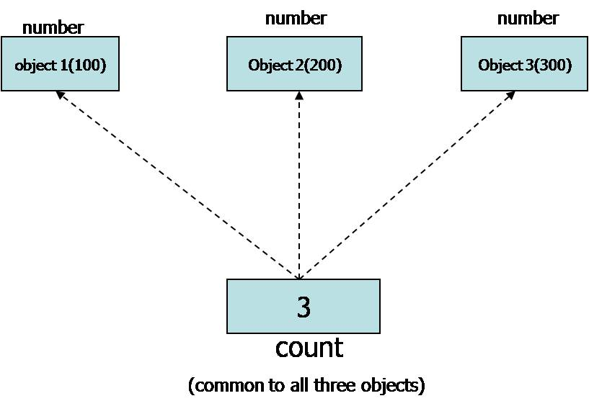
Static in C++
Static Local Variables
Declared inside a function.
Keeps its value between function calls.
Initialized only once, on the first call.
Static Global Variables
Declared outside any function.
Limits the variable’s visibility to the current file only.
Prevents naming conflicts with other files.
Static Functions (at file level)
Declared as static outside any function.
Makes the function private to the file (internal linkage).

Slide 22
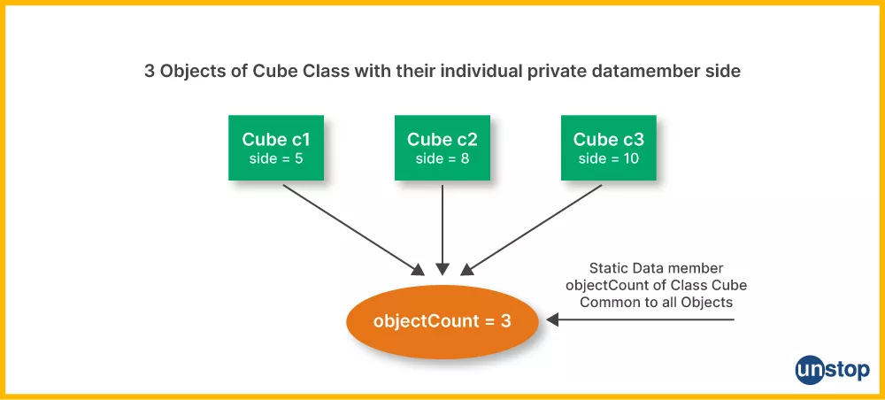
Static in C++ Classes and Structs
Static Data Members
Belong to the class, not to any specific object.
Shared by all instances.
Must be defined outside the class (unless inline in C++17+).
Can be accessed with ClassName::member or through an object.
Static Member Functions
Can be called without creating an object.
Can only access static members (no this pointer).
Useful for utility functions tied to the class.
Lifetime and Scope
Static members exist for the lifetime of the program, not tied to any object.
They’re shared, not duplicated for each instance.

Slide 23
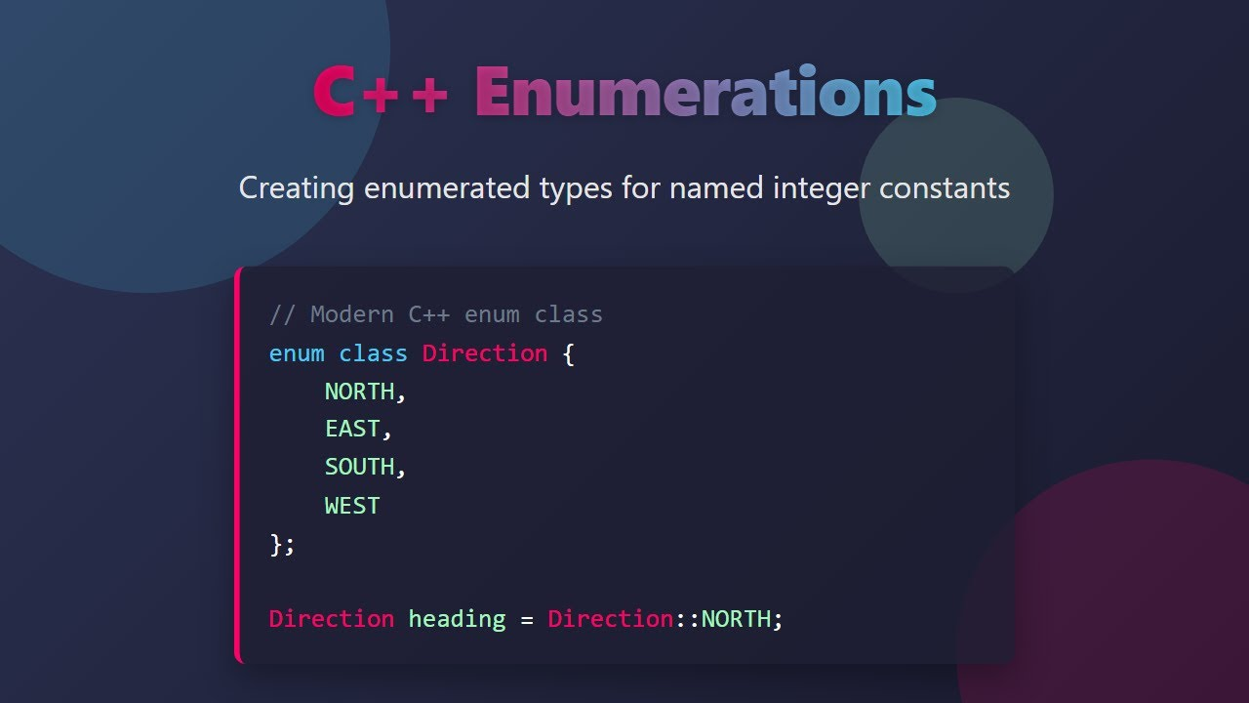
Enums in C++
What is an Enum?
An enum (enumeration) is a user-defined type that assigns names to integral constants.
Improves readability and helps avoid “magic numbers.”
Implicit Values
By default, the first name has value 0, and values increase by 1.
Custom Values
You can manually assign specific values.
Enum Scope
Traditional enums leak their names into the enclosing scope.
Red, Green, etc., can be used directly.
enum class (Scoped Enum – C++11+)
Scoped, type-safe version of enum.
Does not leak names into the outer scope.
Requires prefix to access: Color::Red.

Slide 24
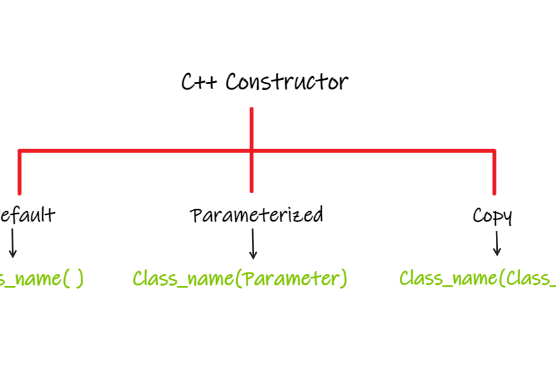
Constructors in C++
Constructor is a special member function automatically called when an object is created.
Its name is the same as the class name, with no return type (not even void).
Used to initialize objects.
Types of constructors:
Default constructor – no parameters.
Parameterized constructor – takes arguments to set initial values.
Copy constructor – creates a new object as a copy of an existing one.
If no constructor is defined, the compiler provides a default one.
Constructors can be overloaded (multiple constructors with different parameters).
Can use member initializer list for efficient initialization.
Constructors can be explicit to prevent implicit conversions.

Slide 25
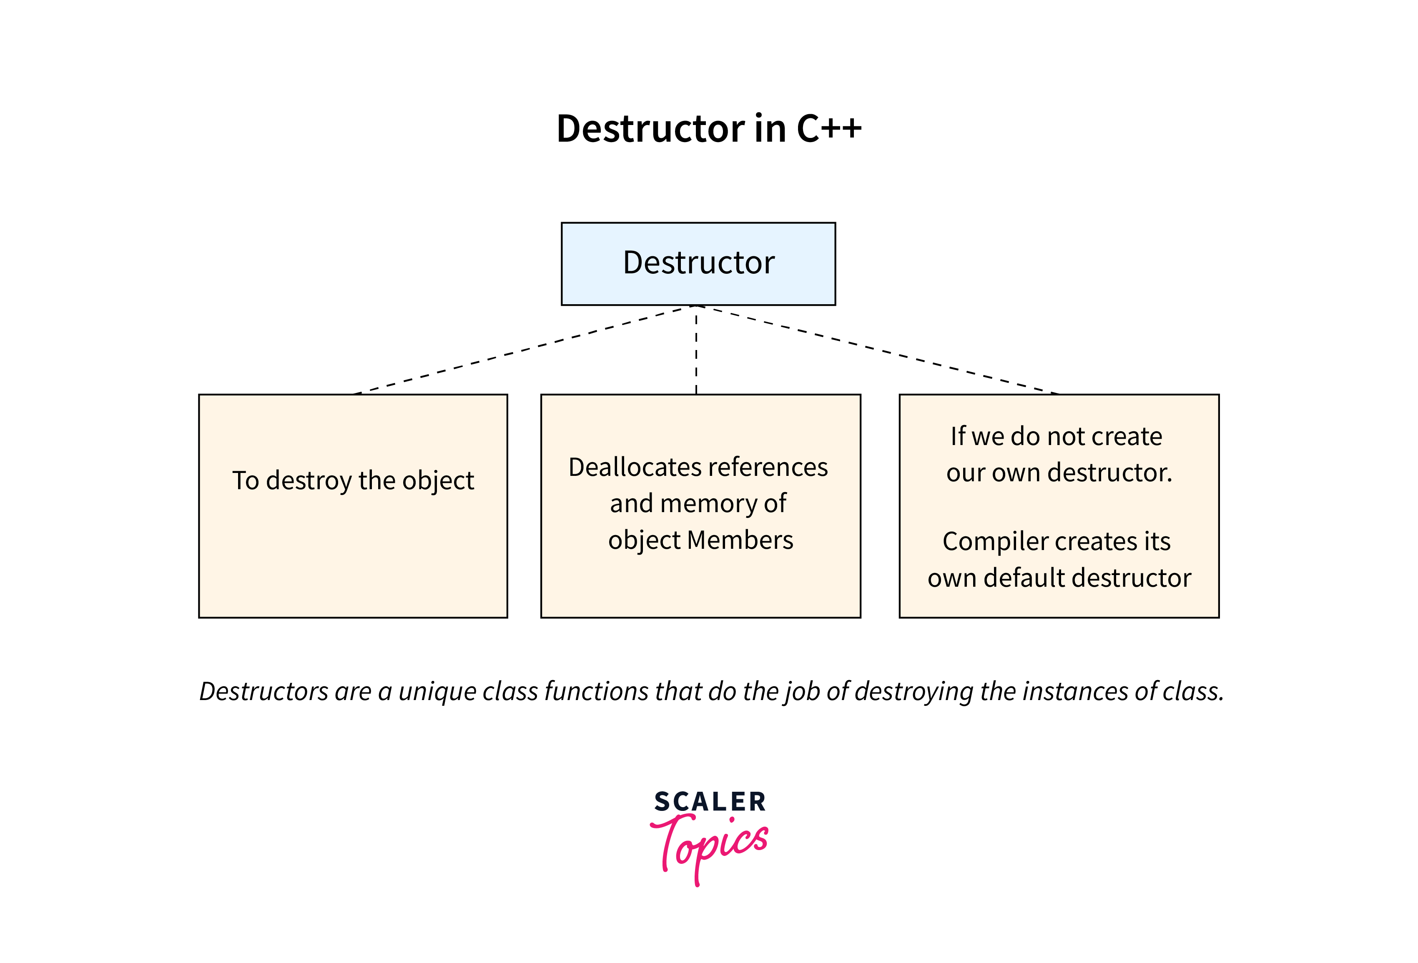
Destructors in C++
Destructor is a special member function called when an object goes out of scope or is deleted.
Its name is the same as the class name, prefixed with a tilde (~).
Used to clean up resources, like memory or file handles.
No parameters and no return type.
A class can have only one destructor (no overloading).
Called automatically in reverse order of construction.
If not defined, the compiler provides a default destructor.
For classes with dynamic memory, always define a custom destructor to avoid memory leaks.
Destructors should be virtual in base classes if the class is intended to be inherited.

Slide 26
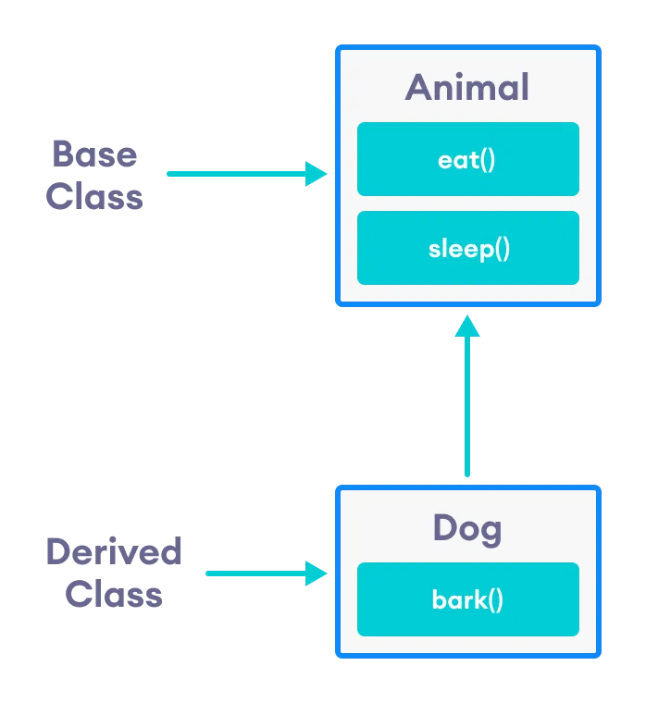
Inheritance in C++
Inheritance allows a class (derived class) to acquire properties and behaviors from another class (base class).
Promotes code reuse and supports hierarchical relationships.
Syntax: class Derived : accessSpecifier Base { ... };
Common access specifiers: public, protected, private – affect how base class members are inherited.
Public inheritance: base’s public/protected members stay public/protected in derived class.
The base class constructor is called before the derived class constructor.
Single inheritance – derived from one base class.
Multiple inheritance – derived from more than one base class.
Use virtual inheritance to solve ambiguity in multiple inheritance (diamond problem).
Supports polymorphism when using base class pointers or references with virtual functions.

Slide 27
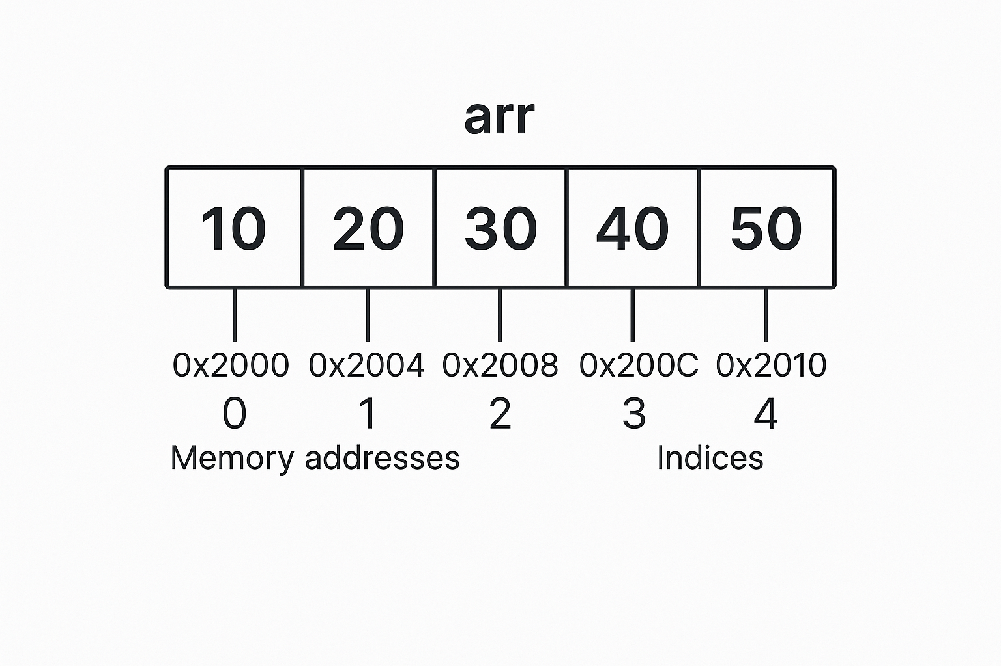
Arrays in C++
Arrays are an ordered collection of elements of the same data type.
They have a fixed size determined at declaration.
Elements are stored in contiguous memory locations.
Access is done via an index, starting at 0.
Declaration syntax: dataType arrayName[arraySize];
Initialization example: int arr[5] = {10, 20, 30, 40, 50};
If fewer values are given, remaining elements are set to 0.
Elements can be read or updated using their index (arr[2] = 99;).
Useful for storing multiple values of the same type efficiently.
Can be single-dimensional or multi-dimensional (e.g., 2D arrays).

